Slide 1
Semantic Segmentation
삼성 AI 교육
컴퓨터 비전
문종환 김단일

Slide 2
Today, we will do
Implement FCN network step by step
Image preprocessing and load vgg-16 network
Bilinear filter and up-sampling layer
FCN-32s (simplest version)
FCN-16s
FCN-8s
Implement DeConvNet (Project)

Slide 3
Semantic Segmentation
Segmenting images based on its semantic notion

Slide 4
Semantic Segmentation
It would be considered as a pixel-level classification problem

Slide 5
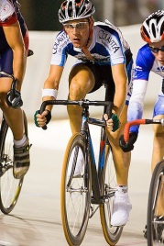
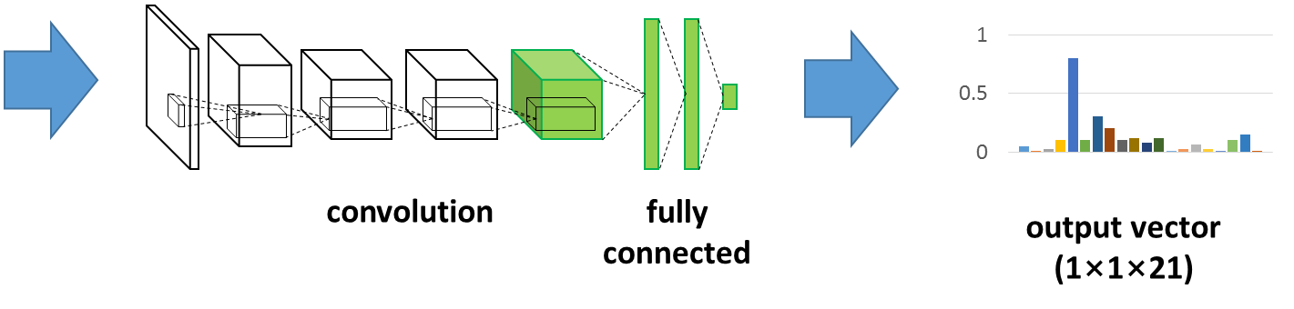
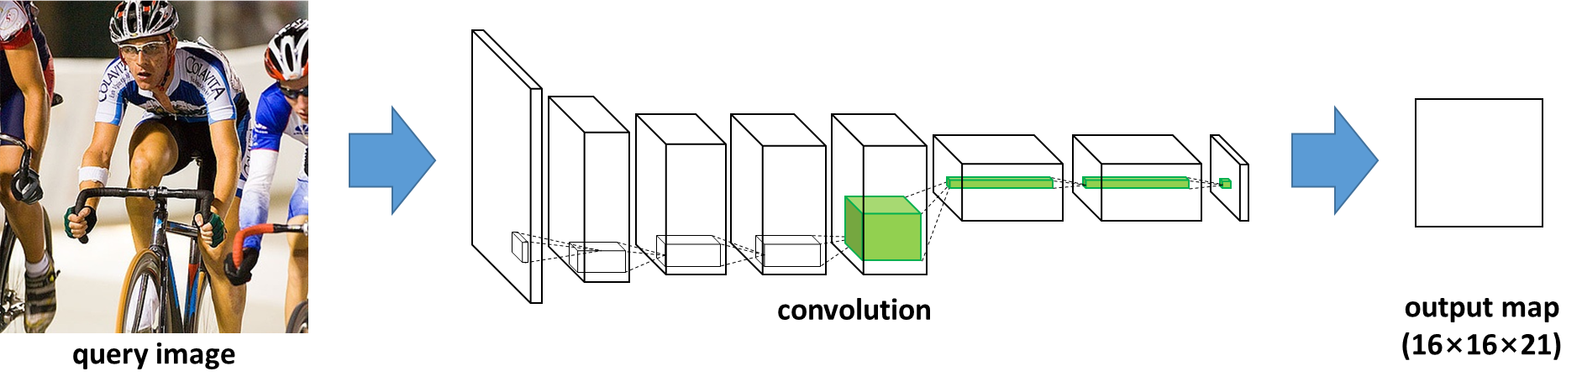
Semantic Segmentation using CNN
Image classification
Semantic segmentation
query image

Slide 6
How to Apply Classification Network?
Main idea 1
Interpreting fully connected (fc) layers as convolution layers
Each fc layer is identical to a convolution layer with a large spatial filter that covers entire input field

Slide 7
How to Apply Classification Network?
Main idea 2
Up-sampling the output map
Feature map size -> input image size
Applying a layer doing a bilinear interpolation
Deconvolution layer

Slide 8
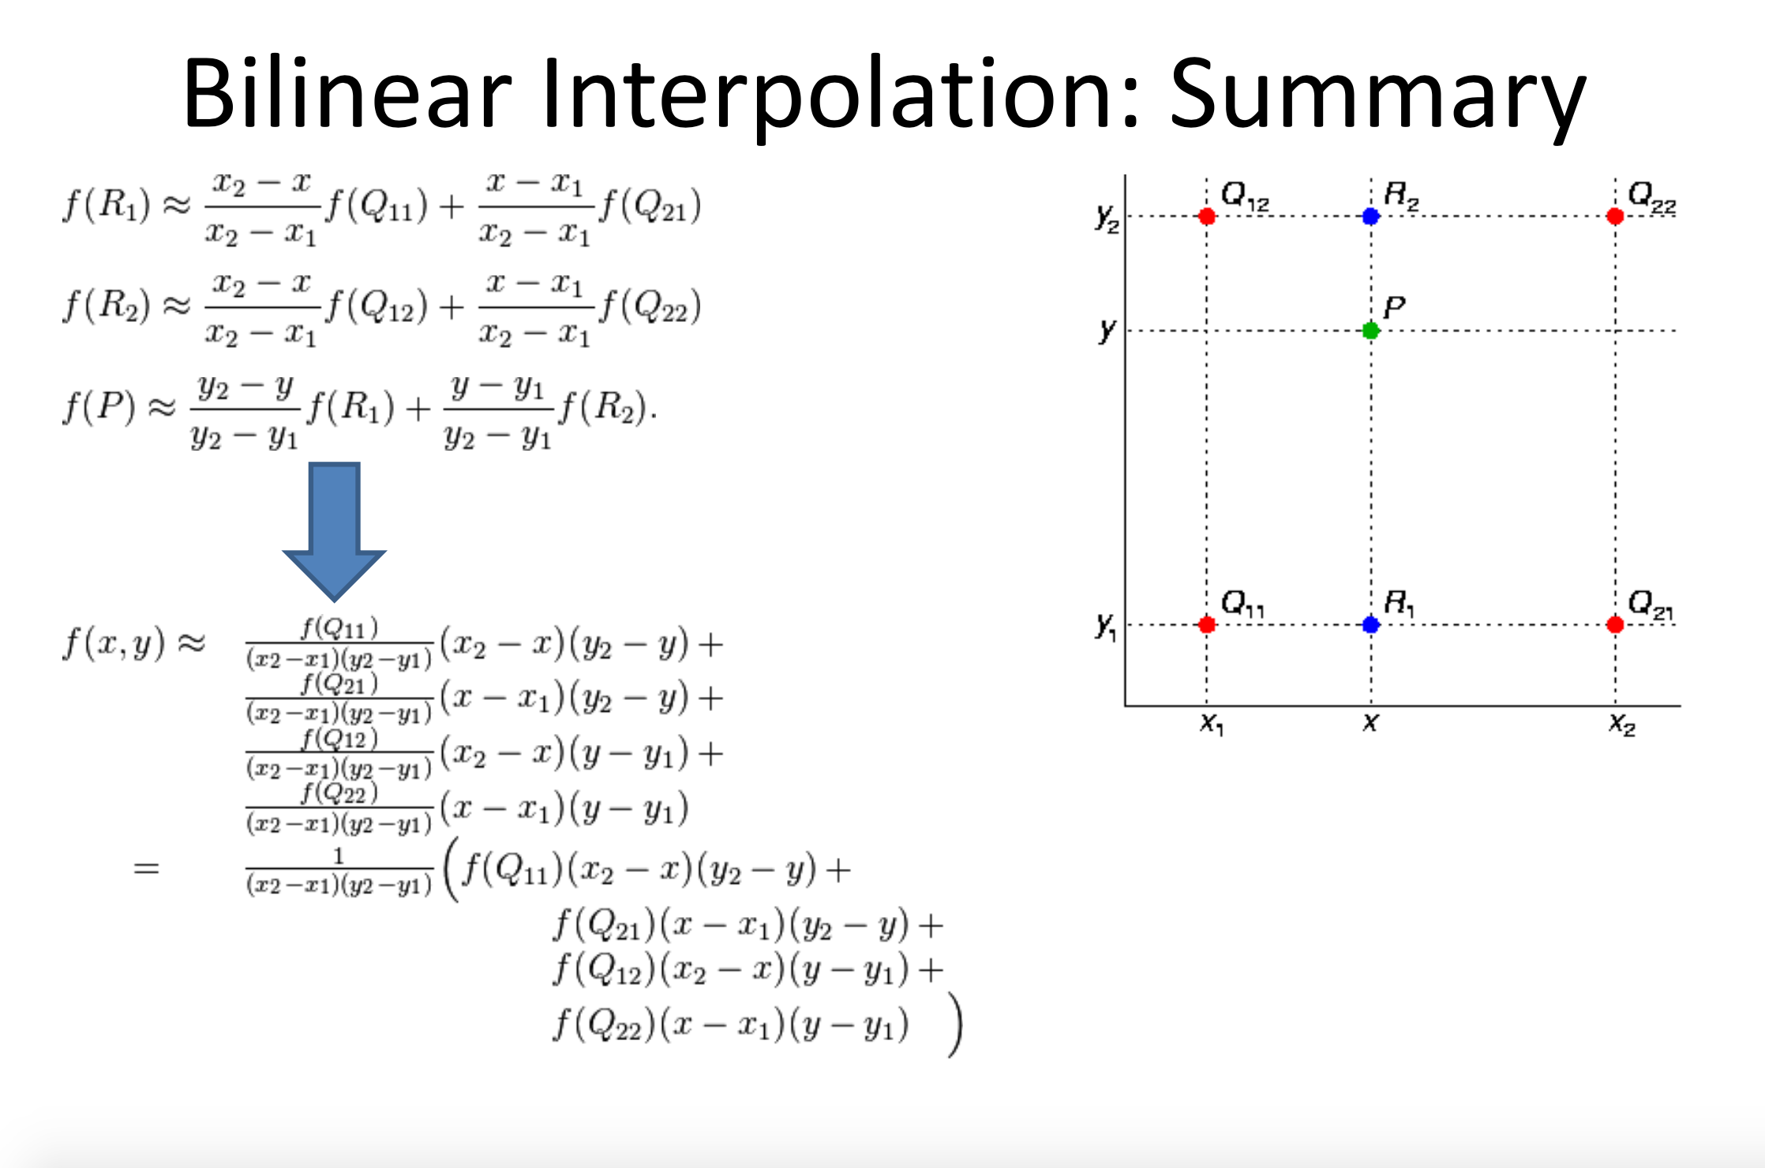
Bilinear interpolation
1 |  | 2
3 |  | 4
1 | 2
3 | 4

Slide 9
Bilinear interpolation
1 | 1.5 | 2
2 | 2.5 | 3
3 | 3.5 | 4
1 | 2
3 | 4

Slide 10
Deconvolutional Layer
Convolution works,

Slide 11
Deconvolutional Layer
Deconvolution works,

Slide 12
Deconvolutional Layer
Deconvolution works,
Simply,
tf.nn.conv2d_transpose(input_layer, filter, output_shape, strides, padding)
tf.nn.conv2d_transpose(input, 3x3 filter, [batch,4,4,channel], [1,2,2,1], ‘SAME’ or ‘VALID’)
https://arxiv.org/pdf/1603.07285.pdf

Slide 13
Deconvolution with Bilinear Filter
Up-sampling with factor 3
Filter size: 5
Stride: 3
Padding: 2
1 | 2
3 | 4
1 |  |  | 2
3 |  |  | 4

Slide 14
Deconvolution with Bilinear Filter
Up-sampling with factor 2
Filter size: 4
Stride: 2
Padding: 1
1 |  | 2
3 |  | 4
1 | 2
3 | 4

Slide 15
Deconvolution with Bilinear Filter
Filter size
2 * factor if factor % 2 == 0
2 * factor - 1 if factor % 2 == 1
Stride = factor (1, factor, factor, 1)
Filter weights
Compute center position in filter size
Center = (filter size + 1) // 2
Center = center - 1 if size % 2 == 1
Center = center - 0.5 if size % 2 == 1
Compute distances from center for all positions
Loc = np.arrange(factor) -> [0, 1, 2, …, factor-1]
Distances = (1 – abs(loc – center) / factor)
Weights
Distances.transpose() * distances
Factor
Filter size
3
5
2
0 | 1 | 2 | 3 | 4
2 | 2 | 2 | 2 | 2
2 | 1 | 0 | 1 | 2
0 | 0.5 | 1 | 0.5 | 0
1 | 0.5 | 0 | 0.5 | 1

Slide 16
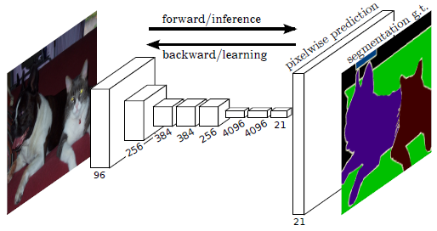
Fully Convolutional Network (FCN)
Network architecture
End-to-end CNN architecture
448x448x3
pixelwise
cross-entropy loss
16x16x21
Fully convolutional layer
Up-sampling
(Deconvolution)

Slide 17
Fully Convolutional Network (FCN)

Slide 18
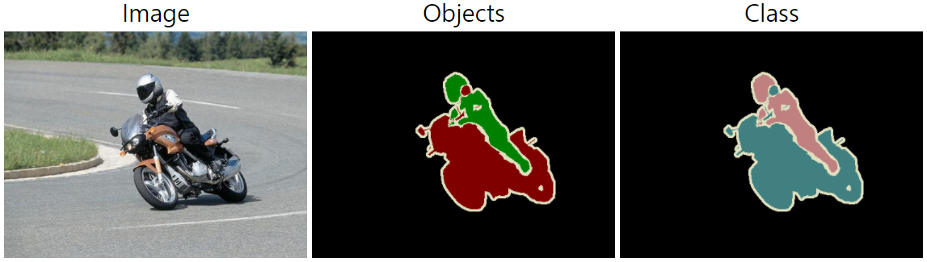
Segmentation Dataset
VOC 2012 dataset
20 classes
1,461 training data / 1,449 validation data
Additional annotations are given from http://home.bharathh.info/pubs/codes/SBD/download.html
MSCOCO provides bigger data with more classes
http://mscoco.org/dataset/#download

Slide 19
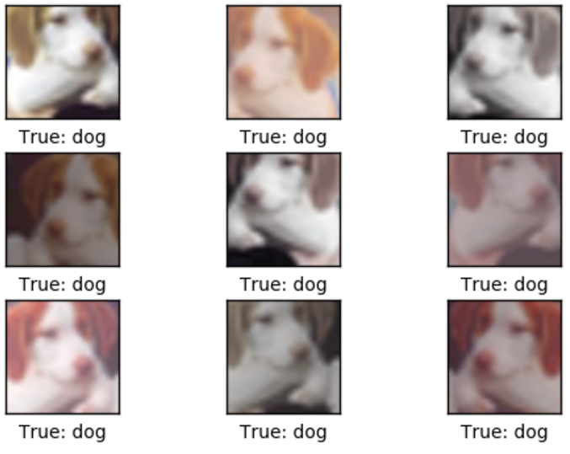
Exercise 1
Download VOC 2012 dataset and check examples
006_fcn/train_FCN.ipynb
Filling TODO 1 in voc_loader.py
Implement random_crop and flipping in _prepro() function
Use Image of PIL module
http://pillow.readthedocs.io/en/3.1.x/reference/Image.html
Crop(left, top, right, bottom)
Transpose(method_option)

Slide 20
Exercise 2
Implement the function to return bilinear filter with a given filter size
Filling the TODO 2 in get_bilinear_filter() at train_FCN.ipynb

Slide 21
Exercise 3
Implement VGG-16 network with fully convolutional layers and load weights from pre-trained model
Filling the TODO 3 in fcn_vgg.py
Refer 004_pretrained_models

Slide 22
Exercise 4
Implement FCN-16s and FCN-32s network
Filling TODO 4 in fcn_vgg.py

Slide 23
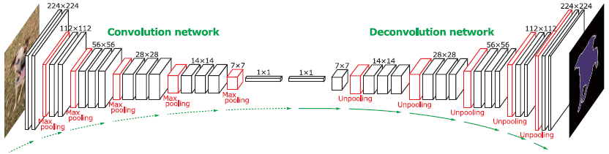
DeConvNet
Convolution network for feature extraction
Deconvolution network for shape reconstruction
Mirrored version of convolution
Pooling => Unpooling
Convolution => Deconvolution
Equivalent with vgg-16 network
Mirrored version of vgg-16 network

Slide 24
Deconvolution Network
Operations
Composed of Deconvolution, Unpooling and Non-linearity
Unpooling
Place activations to pooled location
Preserve structure of activations
Deconvolution
Density sparse activations
Bases to reconstruct shape
ReLU

Slide 25
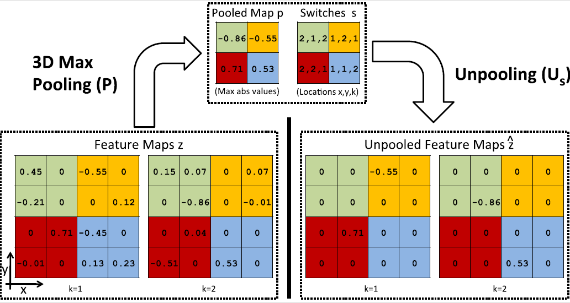
Unpooling

Slide 26
Deconvolution Network

Slide 27
How to Learn?
Instance-wise prediction
Using object proposals
Preserve structure of activations
Identify objects with multi-scales
Two-stage training
1st: center-cropped
2nd: proposal-generated
The network generalize better
Ensemble
Two DeConvNet with different receptive fields

Slide 28
Exercise 5
Implement DeConvNet
Filling TODO 5 in fcn_vgg.py
Use tf.nn.max_pool_with_argmax() instead of tf.nn.max_pool()
Unpooling layer is not implemented in tensorflow officially, so just use the provided unpooling layer in fcn_vgg.py

Slide 29


